Slide 1
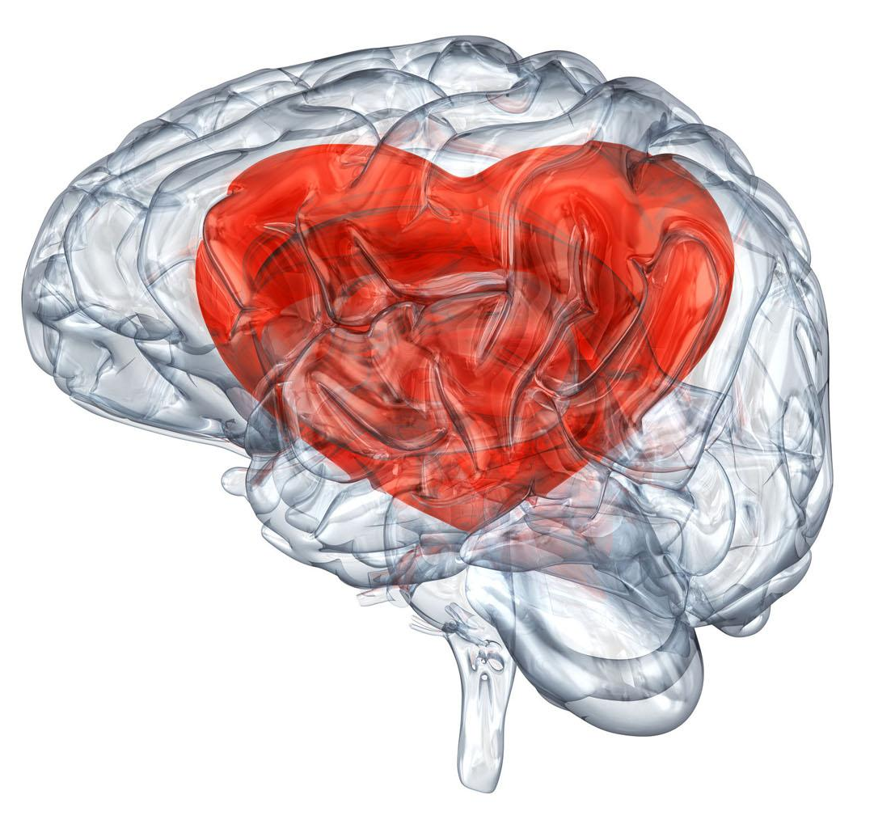
THE NEUROSCIENCE OF LOVE
NSA Journal Club
Presented by: Kira Mills

Slide 2
“There is always some madness in love. But there is always some reason in madness.”
—Friedrich Nietszche

Slide 3
TABLE OF CONTENTS
01
02
03
04
WHY DO WE LOVE?
THE BRAIN
CHEMISTRY
IS LOVE BLIND?
TYPES AND STAGES OF LOVE
The evolutionary reasoning behind why people feel love
What are all of those love drugs?
The regions of the brain that are activated or deactivated in love
How does all of this combine and change over the course of a relationship

Slide 4
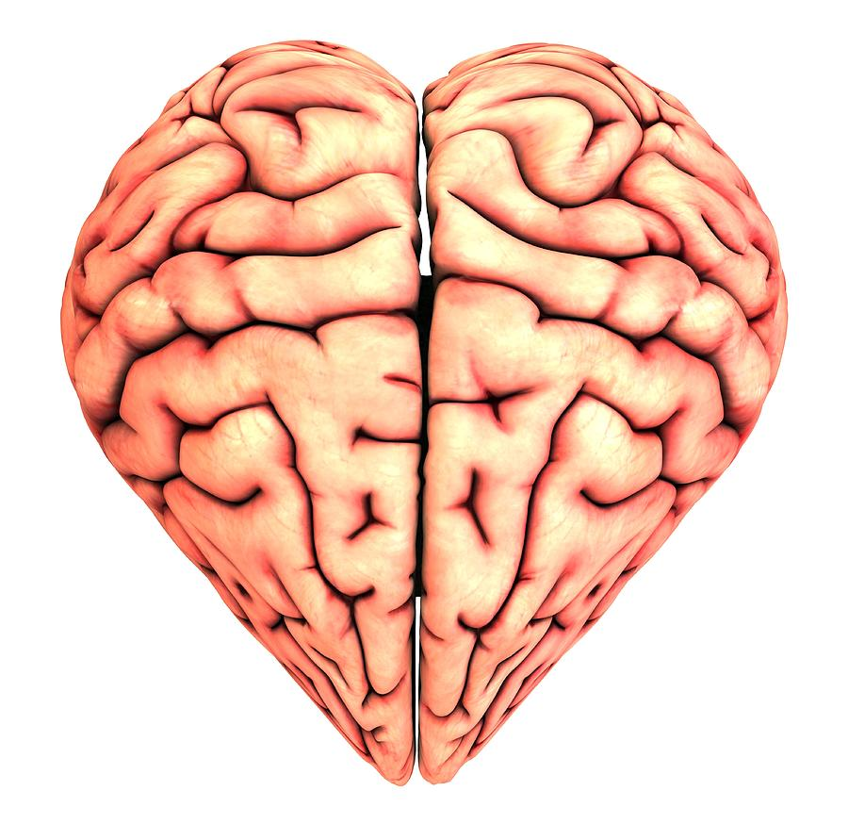
01
Why do we love?
How or why did we evolve the “most loving” brain on the planet?

Slide 5

A COURTSHIP BEHAVIOR
Suggested romantic love developed from courtship neuronal mechanisms thus romantic love is a human form of courtship behavior
Courtship behaviors in lower mammals:
increased energy
focused attention
obsessive following
affiliative gestures
possessive mate guarding
A. De Boer, E.M. Van Buel, G.J. Ter Horst. Love is More than Just a Kiss: A Nuerobiological Perspective on Love and Affection. Neuroscience 201(2012) 114-124

Slide 6
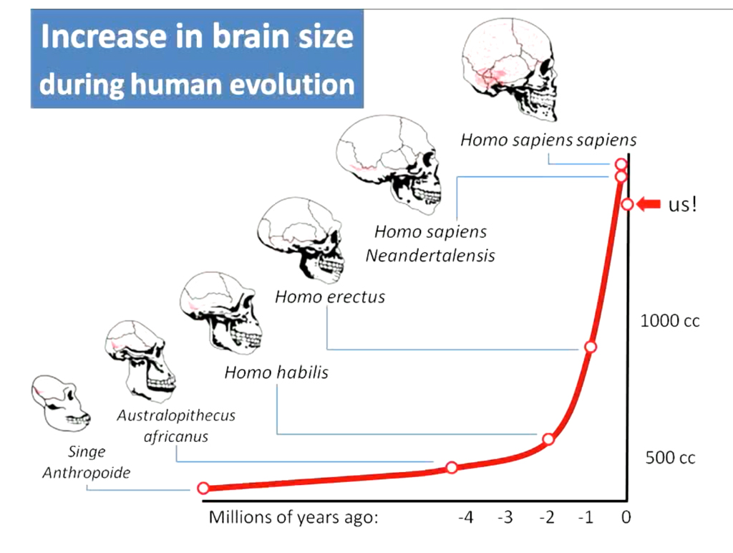
BIGGER BRAINS = BIGGER HEARTS
The growing length of childhood co-evolved with the enlarging of the brain and with the development of complex bonding
Friendships
Romantic love
Parent-child attachment
Group loyalty
Caring for children for longer also saw the proliferation of genes for bonding, altruism and cooperation in the human genome
G.J.O. Fletcher, J.A. Simpson, L. Campbell, N.C. Overall. Pair-Bonding, Romantic Love, and Evolution: The Curious Case of Homo Sapiens. Perspectives on Psychological Science. 10(2015) 20-36

Slide 7
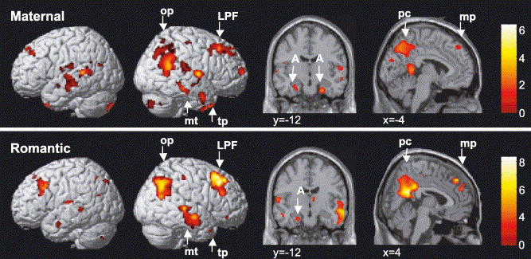
ROMANTIC LOVE FROM MATERNAL LOVE
Evidence that the adult attachment system evolved from the mother-infant attachment system
Both systems designed to keep two individuals together for a certain period
The brain circuits and major hormonal players in both are largely similar
pc = posterior cingulate cortex,
mp = mesial prefrontal/paracingulate gyrus;
mt = middle temporal cortex;
op = occipitoparietal junction;
tp = temporal pole
A. Bartels, S. Zeki. The neural correlates of maternal and romantic love. NeuroImage (2004) 21:3. 1155-1166

Slide 8
02
The Brain Chemistry
Is love really a drug? Or is it more like a disease?

Slide 9
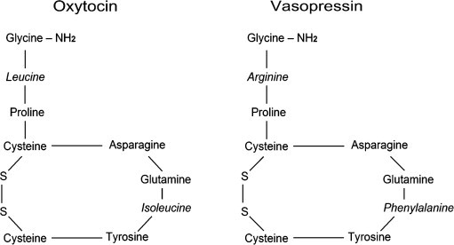
THE NEUROPEPTIDES
OXYTOCIN
VASOPRESSIN
Principle Actions:
Muscle contractions in labor
Releasing milk during lactation
Principle Actions:
Cardiovascular function
Maintenance of blood pressure
Jacek Debiec. From affiliative behaviors to romantic feelings: A role of nanopeptides. FEBS Letters 581(2007) 2580-2586

Slide 10
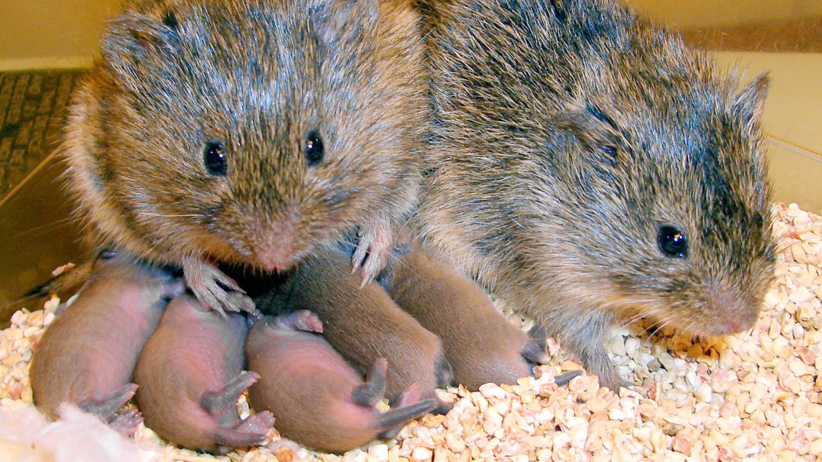
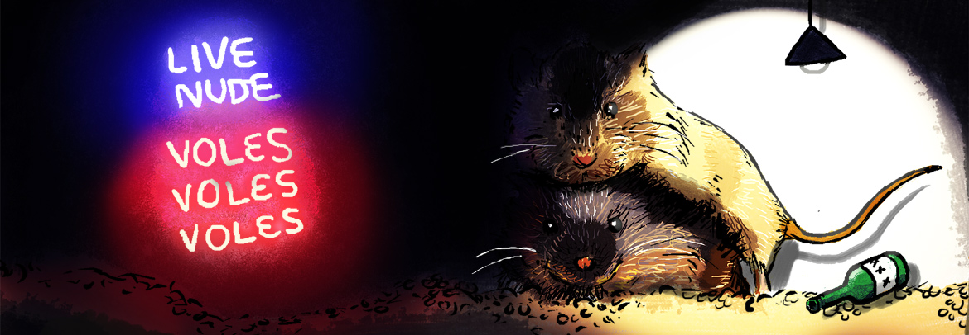
WHAT CAN WE LEARN FROM VOLES?
 | Prairie Voles | Montane Voles
Mating Style | Monogamous | Promiscuous
Neuropeptide Receptors | Oxytocin - Prelimbic cortex & Amygdaloid V1a - Lateral amygdala & Ventral Pallidum | V1a and Oxytocin - Lateral Septum
Mixing it Up | Block oxytocin and vasopressin release → promiscuous | Express V1a receptor of prairie vole → monogamous
A. De Boer, E.M. Van Buel, G.J. Ter Horst. Love is More than Just a Kiss: A Neurobiological Perspective on Love and Affection Neuroscience 201(2012) 114-124

Slide 11
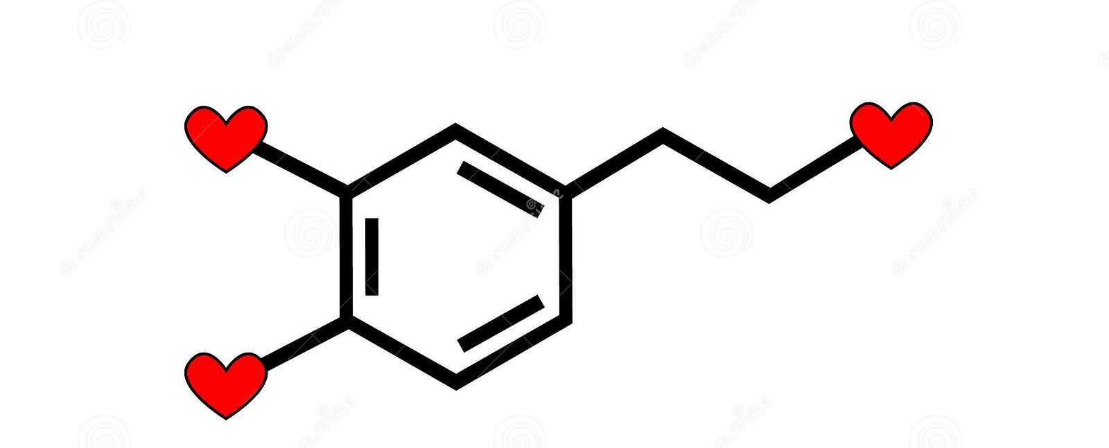
DOPAMINE
Oxytocin & Vasopressin interact with the dopamine reward system → makes love rewarding
Receptors:
D1 receptor stimulations block formation of pair-bonds
D2 receptor stimulations facilitate partner preference
Dopamine has a higher affinity for D2 than D1, but after pair-bond formation see up-regulation in D1 density
Prevents formation of new pair-bonds
G.J.O. Fletcher, J.A. Simpson, L. Campbell, N.C. Overall. Pair-Bonding, Romantic Love, and Evolution: The Curious Case of Homo Sapiens. Perspectives on Psychological Science. 10(2015) 20-36

Slide 12
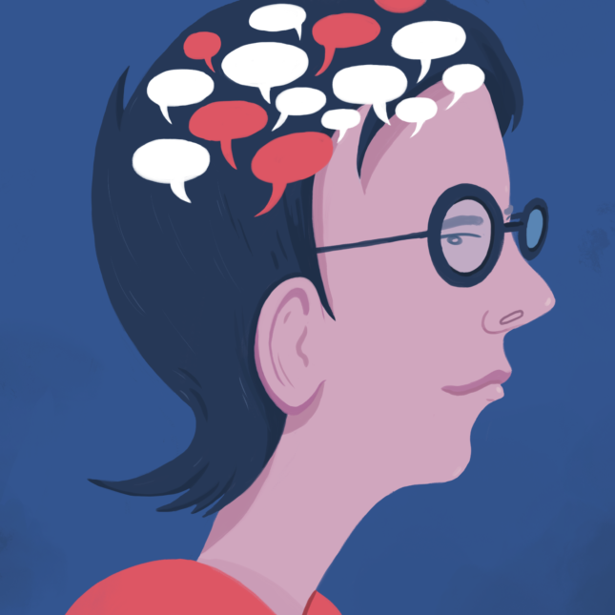
SEROTONIN
Early stages of romantic love show depletion of serotonin
Also found in several psychiatric disorders
Early stages show similarities to OCD
Anxiety, stress, obtrusive thinking
12-18 months after falling in love, see a return to normal levels of serotonin
Marazziti D, Akiskal HS, Rossi A, Cassano GB (1999) Alteration of the platelet serotonin transporter in romantic love. Psychol Med 29(3):741–745.

Slide 13
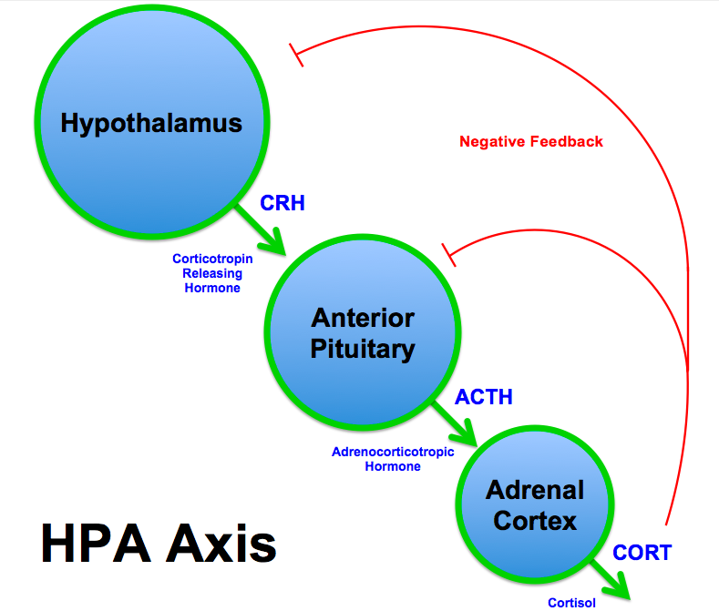
HPA AXIS & CORTISOL
In early stage romantic love, hypothalamic pituitary adrenal (HPA) axis activity and cortisol levels are increased → more stress and insecurity
May be necessary to overcome initial neophobia
Increased stress levels trigger formation of pair-bonds
12-24 months after falling in love,
Decreased stress levels and increased feelings of security
Marazziti D, Canale D (2004) Hormonal changes when falling in love. Psychoneuroendocrinology 29(7):931–936.

Slide 14
03
Is Love Blind?
Why is it that we feel so secure with our loved ones and like they can do no wrong?

Slide 15
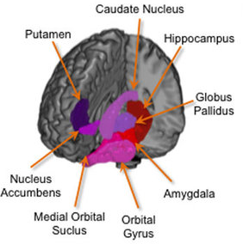
ACTIVATED BRAIN AREAS
AREAS
WHAT DOES THAT MEAN?
Medial Insula
Anterior Cingulate Cortex
Hippocampus
Striatum
Nucleus Accumbens
Hypothalamus
These areas are important components of the brain reward system and all contain high concentrations of dopamine
Many regions are adjacent to, or in the case of hypothalamus overlap with, regions that show increased activity during sexual arousal

Slide 16
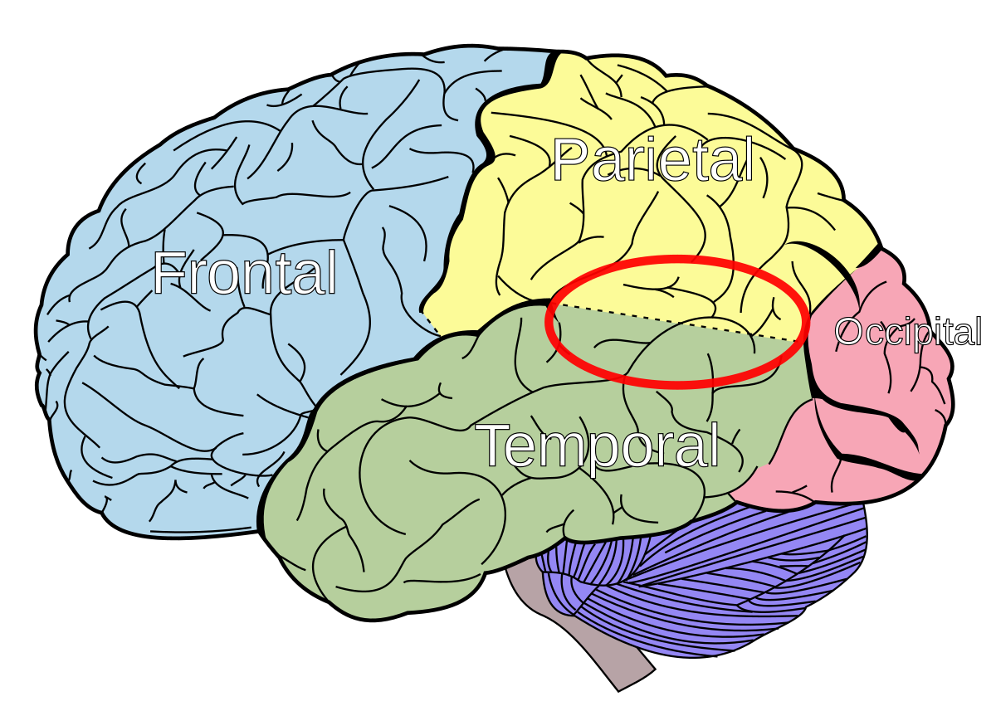
DEACTIVATED BRAIN AREAS
AREAS
WHAT DOES THAT MEAN?
Amygdala → lessening of fear
Frontal cortex → inability to accurately or harshly judge partner
Prefrontal cortex, temporal poles, parietotemporal junction → decrease in Theory of Mind ability, or obtain an imagined “unity-in-love”
Amygdala
Frontal Cortex
Prefrontal Cortex
Temporal Poles
Parietotemporal Junction

Slide 17
04
The Stages of Love
A relationship is like a roller coaster of emotions, why?

Slide 18
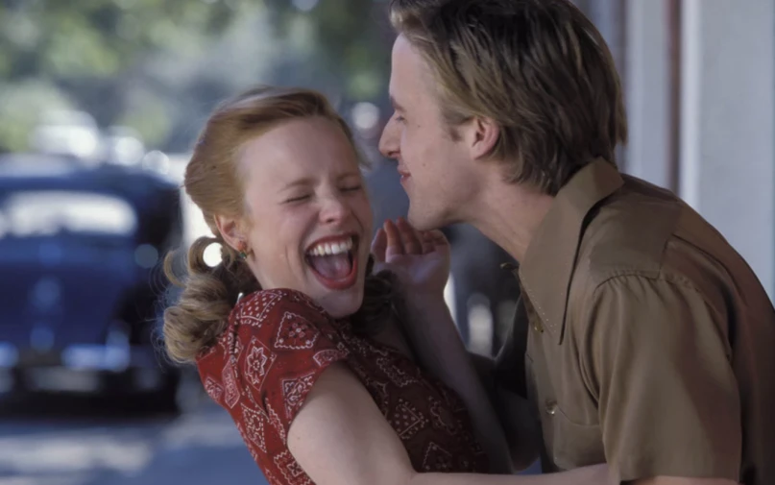
PHASE 1: BEING IN LOVE
High passion, rapid rise in intimacy, and increased commitment
Lasts ~6 months
Excitation and stress
High cortisol and NGF levels
Low FSH, testosterone, and serotonin

Slide 19
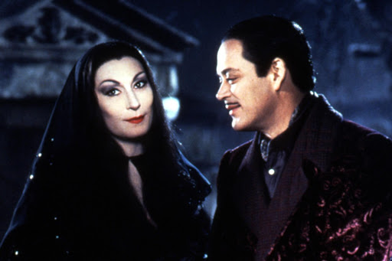
PHASE 2: PASSIONAL LOVE
The initial phase of euphoria, excitation and stress evolves into feelings of safety, calm and balance
Passion remains whereas intimacy and commitment increase steadily
Oxytocin and vasopressin believed to be major factors as you form a strong pair-bond

Slide 20
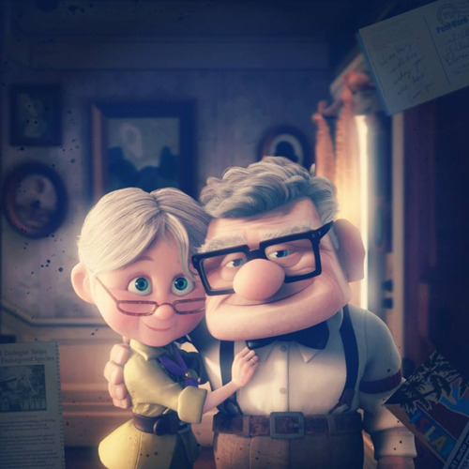
PHASE 3: COMPANIONATE LOVE
Characterized by decrease in passion while intimacy and commitment remain high
Quite similar to friendships
Oxytocin and vasopressin dominate, reinstating and maintaining pair-bond
Many relationships end before this, indicating the transition from phase 2 to phase 3 is particularly fragile

Slide 21
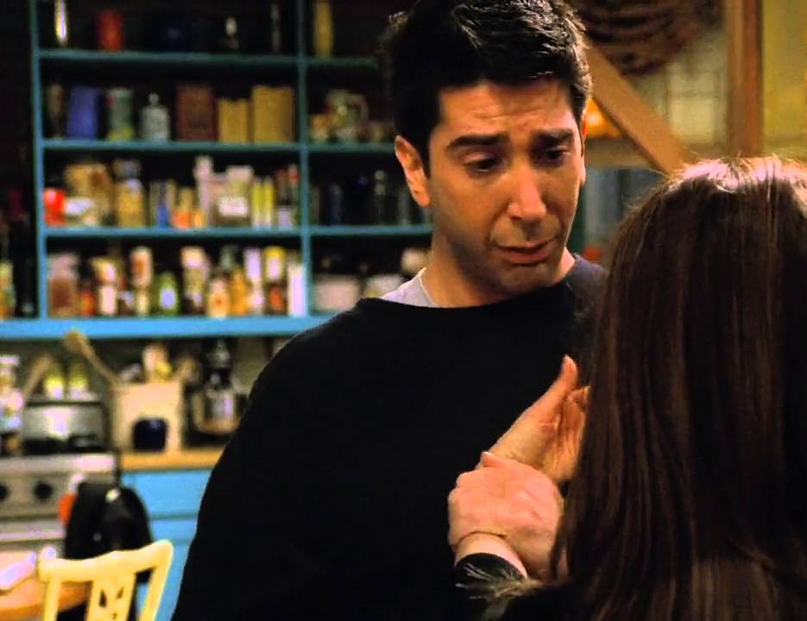
THE BREAKUP OF A RELATIONSHIP
Increase in stress hormones
Increased activity in ventral tegmental area, ventral striatum, pallidum, and putamen
Uncertainty about future after breakup
Parts of orbitofrontal cortex activated
Later stages of breakup show this gets deactivated, showing people learning to accept and deal with breakup
Notes:
Increased activity in ventral tegmental area, ventral striatum, pallidum, and putamen → indicated in choices for uncertain rewards and delayed responses
→ associated with Theory of Mind and implementing appropriate adjustments in behavior

Slide 22
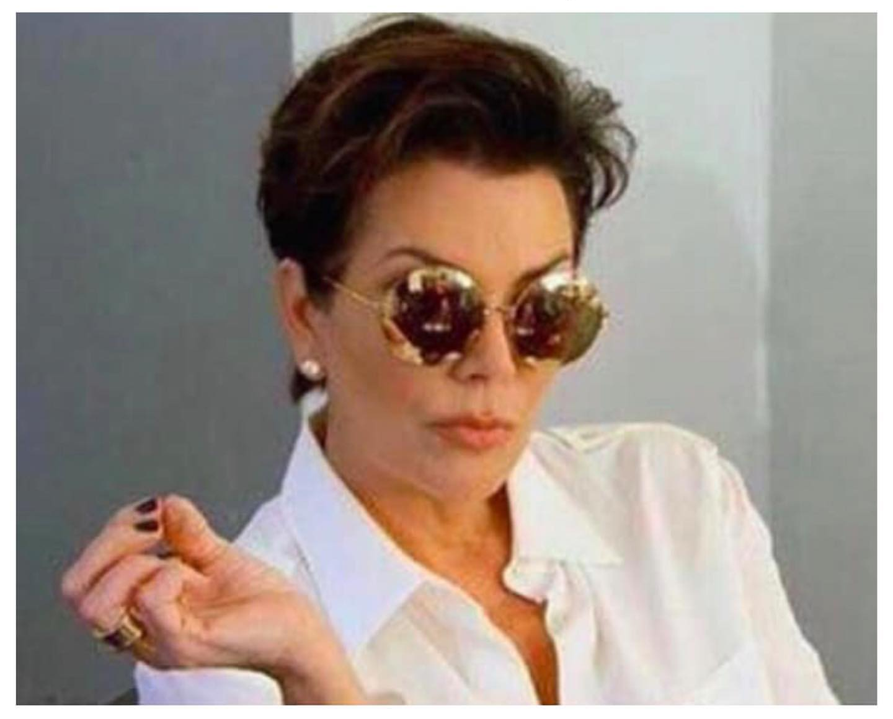
END ON A HIGH: MATERNAL LOVE
There are a lot of similarities between romantic and maternal love in terms of neurobiology, but as Zeki states “if you can tell the difference, it’s because different brain areas are involved”
See strong activation in parts of brain specific for faces in maternal love
Importance of reading children’s facial expressions to ensure their well being

Slide 23
Thank You
Any questions?

